Slide 1

November 13th,2022
Discrimination of auditory hallucination in schizophrenia based on the brain networks：an EEG study
Jiuju Wang, Wentian Dong
Peking University Sixth Hospital

Slide 2
Introduction
Methods
Results
Discussion

Slide 3

Introduction—Auditory Verbal hallucination
Auditory Verbal Hallucination (AVH) is a typical symptom presenting in about 64.3% to 83.4% of patients and is one of the diagnostic criteria of schizophrenia (V et al. 2020)
Patients with AVH often have abnormal experiences of hearing voices without external sound stimuli and are often regarded as developing a higher severity of schizophrenia
Understanding the neural basis of AVH is important for the clinical diagnosis and further developing new treatment methods for the illness.
Notes:
男生比女生多。那么谁发现了 阅读障碍，阅读障碍研究是 怎么展开的呢？

Slide 4
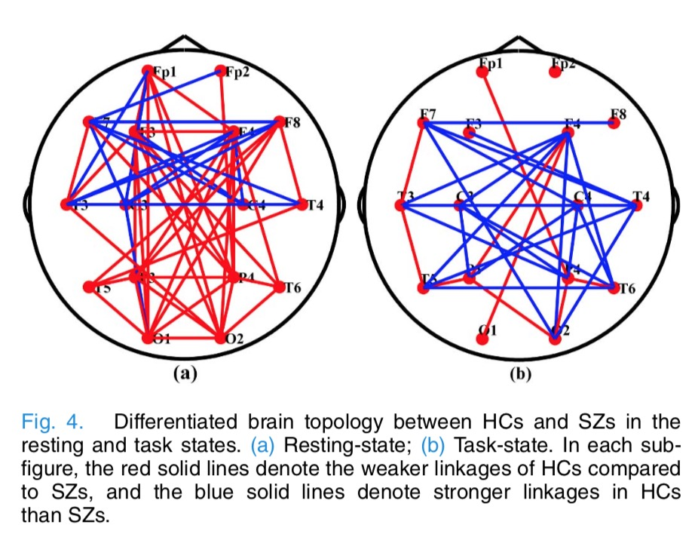
Introduction—Schizophrenia
SCZs have cognitive impairments—P300—endophenotype
Both AVH and non AVH experience severe cognitive impairments
dysconnectivity hypothesis—functional connectivity between prefrontal and temporal regions
Using various electrophysiological indicators and brain network features to detect difference of AVH and non-AVH
Li(#), Wang(#) et al., 2019

Slide 5
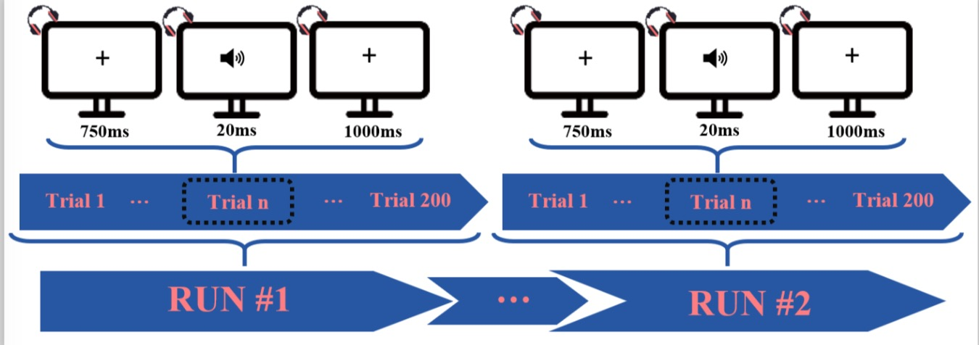
Methods
Sample characteristics of patients and healthy controls [mean (S.D.)]
 | non-AVH (n = 19) | AVH (n = 23) | HC (n = 29) | P value^{b}
Age | 27.84(7.88) | 29.26(8.76) | 25.66(6.59) | 0.241
Gender (M/F)ª | 11/8 | 6/17 | 16/13 | 0.057
Education | 14.53 (2.93) | 13.52 (2.71) | 15.24 (2.26) | 0.067
Onset | 22.32 (7.06) | 23.48 (8.08) | -- | 0.626
Length of illness | 5.54 (6.31) | 5.80 (6.72) | -- | 0.896
BPRS | 34.89 (10.10) | 35.17 (9.06) | -- | 0.925
Daily Chlorpromazine equivalent (mg) | 399.18 (192.25) | 566.58 (317.83) | -- | 0.051
Symtop amplifier (Beijing, China)
16-channel Ag/AgCl
Sample: 1000 Hz
Online bandpass filtered at 0.05-100 Hz
Auditory oddball task:
Stimuli:1000Hz(80%) / 2000Hz(20%) pure-tone
Notes:
The auditory oddball task protocol and the timeline of the task trial used in our study.
Brief Psychiatric Rating Scale test

Slide 6
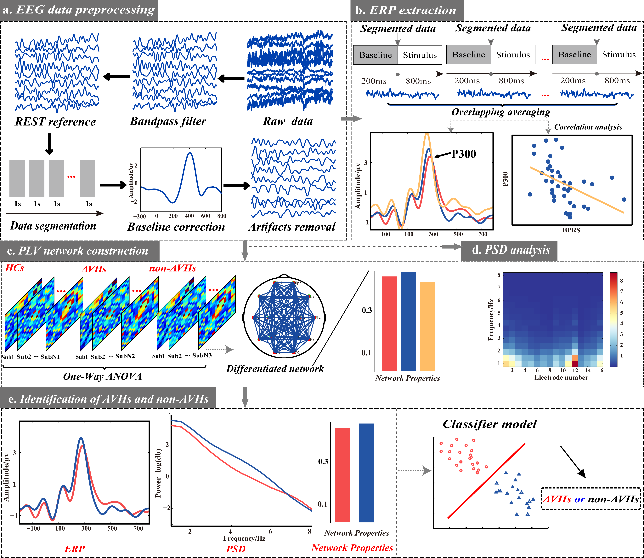
Methods—The data analysis protocols
(a) EEG data preprocessing.
(b) ERP extraction.
(c) PLV network construction.
(d) PSD analysis.
(e) Identification of AVHs and non-AVHs

Slide 7
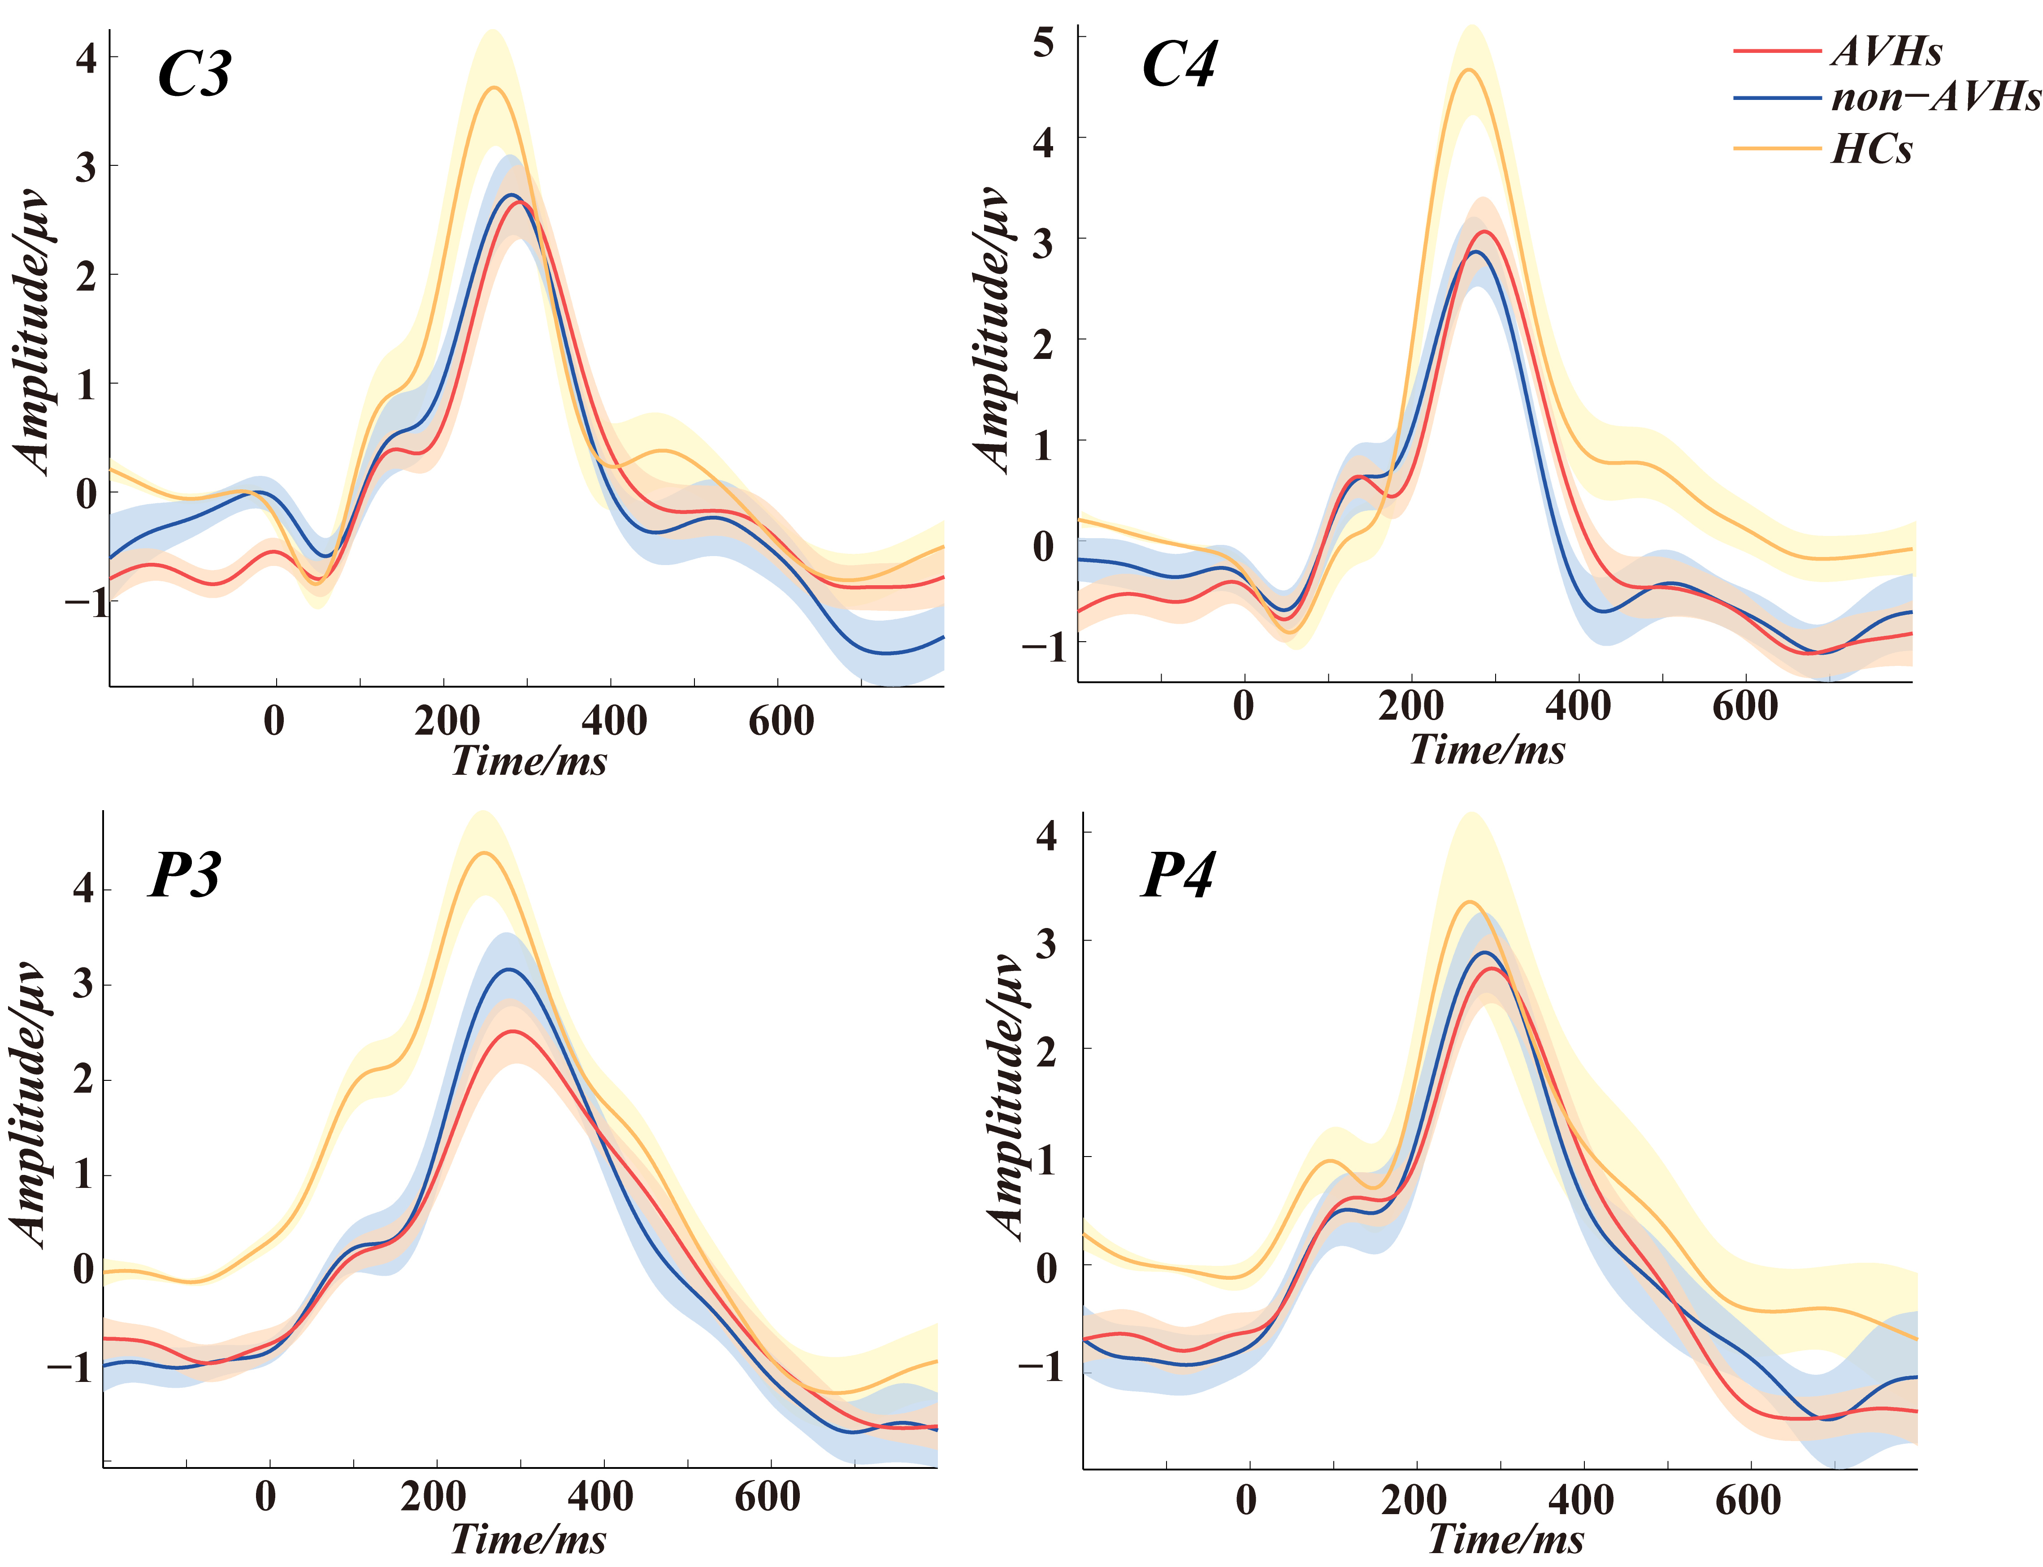
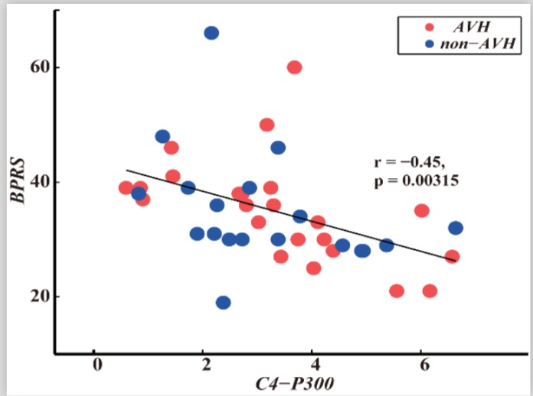
Results—P300 waveforms and relationships to clinical symptom
Notes:
The waveformss correspond to the target-evoked ERPs for these three groups
The potential relationships between BPRS scores and P300 amplitudes for both non-AVH and AVH groups

Slide 8
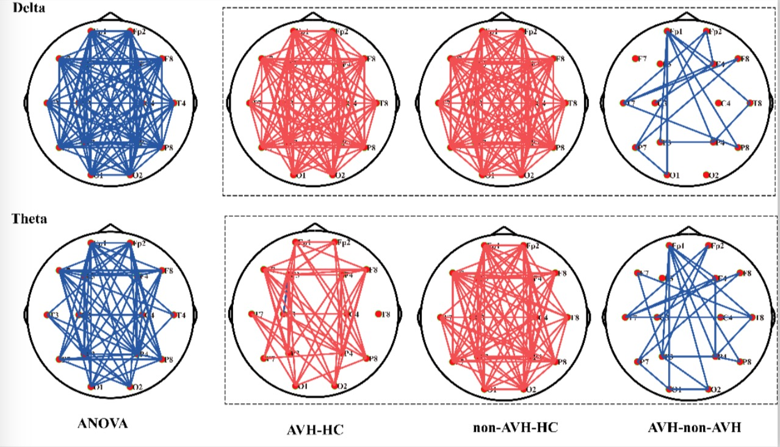
Results—task-state brain network
AVH, non-AVH > HC
AVH< non-AVH: frontal-temporal and frontal-parietal networks
red lines –higher network connectivity
blue lines –lower network connectivity

Slide 9
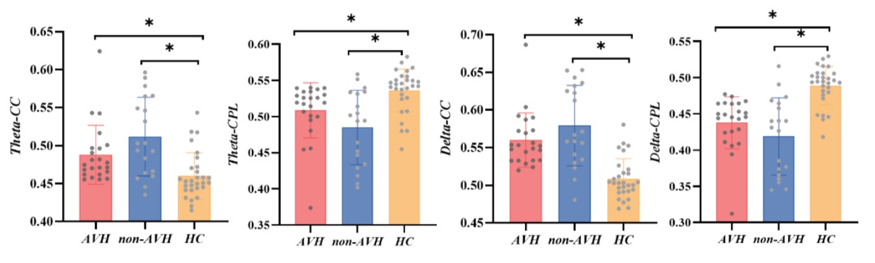
Results—The network properties in delta and theta band
☨
☨
☨
☨
CC(clustering coefficient )—local connectedness
CPL(characteristic path length )—global connectedness
the higher CC and shorter CPL indicate stronger connectivity.
AVH<non-AVH
Notes:
CC indicates the local connectedness of a graph, while CPL indexes the global connectedness; the higher CC and shorter CPL indicate stronger connectivity.
clustering coefficient
characteristic path length

Slide 10
Results— Classification of non-AVH and AVH based on the P300 and network parameters
 | P300 | PSD | network Properties
ACC (%) | 64.29 | 59.52 | 80.95
AVH SEN (%) | 91.30 | 73.91 | 95.65
non-AVH SEN (%) | 31.58 | 42.11 | 63.16
F1-score(%) | 60.46 | 58.44 | 80.27

Slide 11
Discussion
P300 is sensitive to differentiate schizophrenia and healthy controls, it does not seem to be sensitive enough to characterize the AVHs
Weaker left temporal-parietal and fronto-parietal connections in AVHs→ perceptual misrepresentations, speech perception, and production deficits
Brain network properties (CC and CPL) of both delta and theta bands may be good features to discriminate the schizophrenia patients who had AVH from those without AVH.

Slide 12
Thanks for your attention!

